Slide 1

The 10 Most Common Azure Mistakes (and how to fix them)
scottsauber
Slides at scottsauber.com

Slide 2
Audience
Anyone using Azure
Technically some of these translate to AWS too

Slide 3
Agenda
Series of lightning talks
Account Organization
Naming Standards
Tagging Standards
Azure Policies
Managed Identities
DefaultAzureCredential
Requiring TLS 1.2+
Federated Credentials
Budgets and Cost Alerting
Reservations
Savings Plans

Slide 4
Goals
Ideas on how to make your Azure more maintainable, cost effective, and more performant

Slide 5





Who am I?
Director of Engineering at Lean TECHniques
Microsoft MVP
Dometrain Author
Redgate Community Ambassador
Co-organizer of Iowa .NET User Group

Slide 6

Why this talk?

Slide 7

Account Organization

Slide 8
Problem: OOB MVC Folders By Responsibility
Folder Structure
All of these live in their own separate folders and most are required to add a new feature
Controllers
Views
Models
wwwroot/css
wwwroot/js
Adds navigation friction
Scope of a feature is scattered
Makes it hard to add, delete or extend existing features

Slide 9
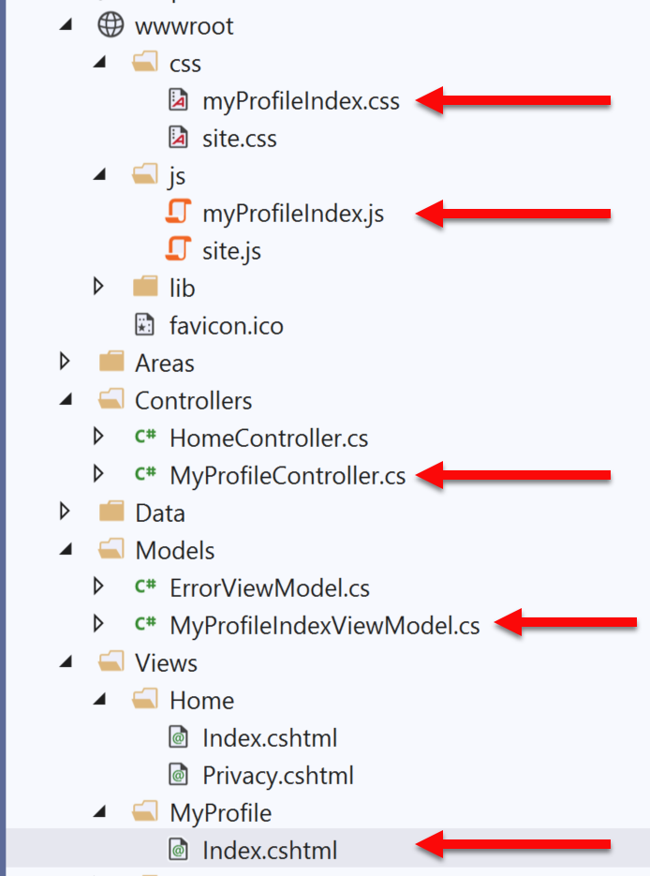
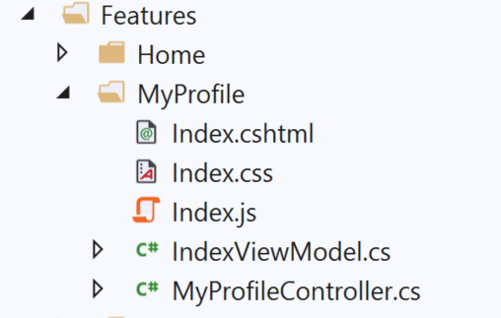
Solution: Use Feature Folders
Folder Structure
Grouping by Feature, not by Responsibility, results in easier maintenance
Related things remain together (High Cohesion)
MVC out of the box:
Feature Folders:

Slide 10
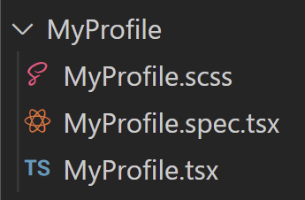
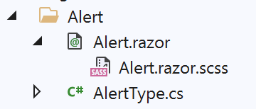

Solution: Use Feature Folders
Folder Structure
React:
Blazor:
scottsauber
Notes:
Some even put tests in their feature folders

Slide 11
But mah layers!!!1one
Folder Structure
I used to do horizontal csproj’s
.Data, .Business, .Common, .Models, .Api
Now I just do two projects
.Core and .Api (or .Web or .Console or whatever entrypoint is)
I slice the folders here vertically too
Plus corresponding Test projects of course (more later)
Slice horizontally only if you’re publishing packages to NuGet or internally

Slide 12
Feature Folder Extra Resources
Folder Structure
Soap analogy
How to do this in ASP.NET Core
My blog post
Steve Smith’s Blog on Feature Folders vs. Areas
Refactoring to Vertical Slice architecture (featureFolders++)
Derek Comartin
scottsauber

Slide 13

⚠️ == ❌

Slide 14
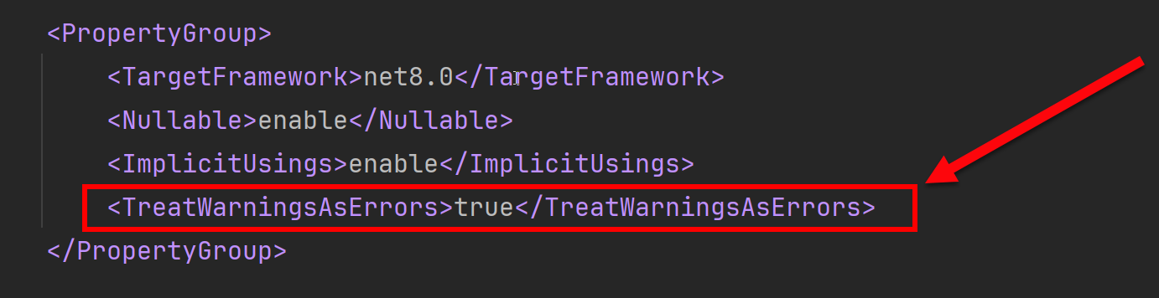
Treat Warnings as Errors
Treat Warnings As Errors
Build/Compiler warnings don’t exist in my world
Error or Nothing
scottsauber

Slide 15

Logging “Best Practices”

Slide 16
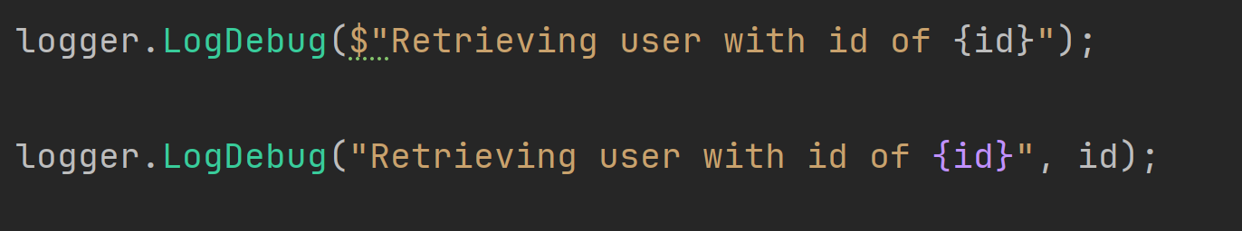
Logging “Best Practices”
Logging “Best Practices”
Use Serilog as logging framework
Use ILogger everywhere, not Serilog directly
Use structured logging, not concatenation
But… Azure Log Analytics workspaces cap at 500 columns
Each log should have key bits of information on it
User ID, Correlation ID, Request URL, App Version, etc.
Use Serilog’s Log Context
“We need to log that”
Logs vs Metrics vs Audits

Slide 17
Logs
Logging “Best Practices”
Developer focused
Example: log an exception or log response from external API
Log Levels
Debug vs Information vs Warning vs Error vs Critical
Stop abusing Information! You probably meant Debug
Clean up your Warnings and Errors!
How long does my log store keep logs?
How reliable is my log delivery system
It’s okay to not have 100% guaranteed delivery of logs
How does Serilog work?

Slide 18
Metrics
Logging “Best Practices”
Two types
Application
CPU, Network, Response Times, Queue Depth, etc.
Business
How many times did someone click that button
How long do we need to keep Metric data?
It may or may not be acceptable to miss some data
What data store are we using?

Slide 19
Audits
Logging “Best Practices”
Recording who, did what, and when in your application
Usually for legal, compliance, or traceability reasons
Losing any data is unacceptable
Store audits with the same data store as the data that’s being audited

Slide 20

Global Authorize Attribute via FallbackPolicy

Slide 21
Problem: Security is Opt-In
Global Security
You have to remember to add a [Authorize] attribute everywhere
Or you have to remember to inherit from a custom BaseController
You forget? Oops you’re wide open to the world!

Slide 22
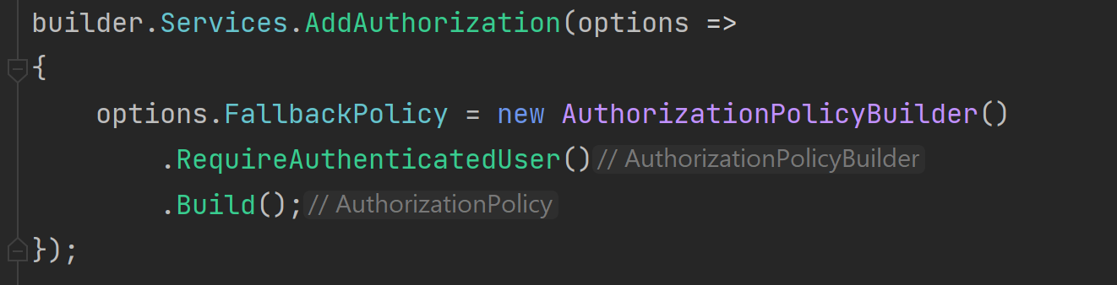
Solution: FallbackPolicy
Global Security
A Fallback Policy is the policy that gets evaluated if no other policy is specified

Slide 23

Validation

Slide 24
Validation – What’s wrong with Data Annotations
Validation
Only work well for simple scenarios
Hard to make custom ones
Hard to unit test
Separate annotations for each property
Can get “tall”
SRP violated
Model + Validation combined into one class
scottsauber

Slide 25

Solution: Use FluentValidation
Validation
Fluent interface
Business rules are easy to maintain and read
Easy to show a stakeholder
Easy to test
Integrates with ModelState.IsValid
634M downloads
https://github.com/JeremySkinner/FluentValidation
scottsauber

Slide 26
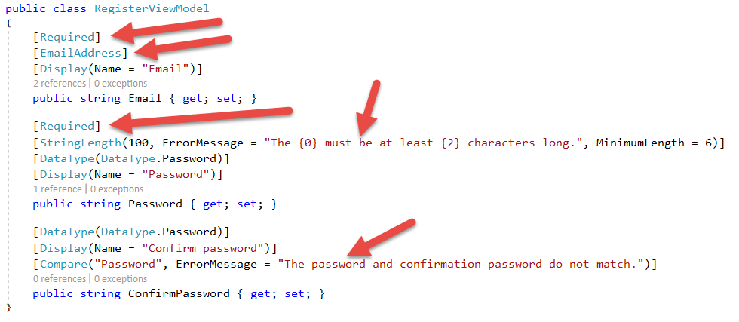
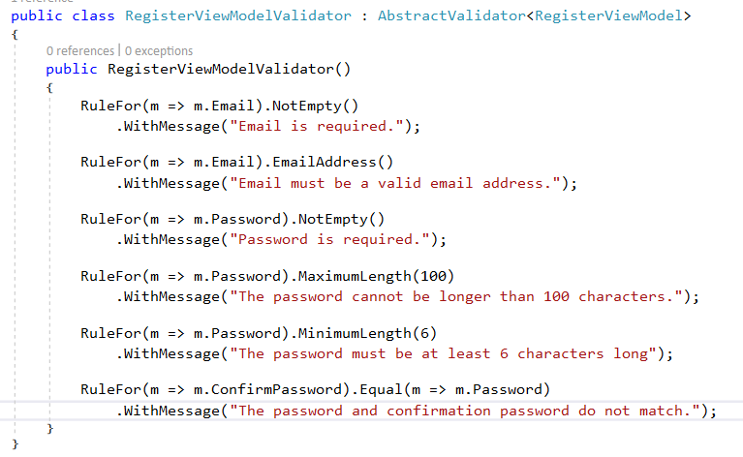
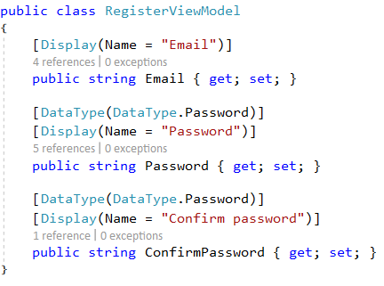
Template Code:
Validation
Refactored with Fluent Validation:

Slide 27
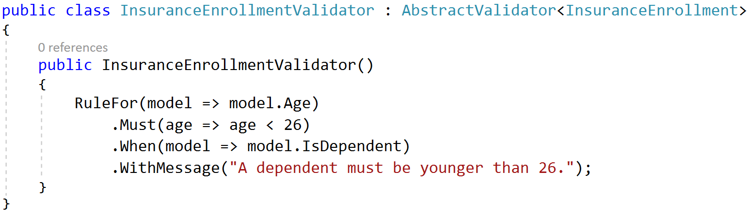
A Rule that only exists if….
Validation

Slide 28
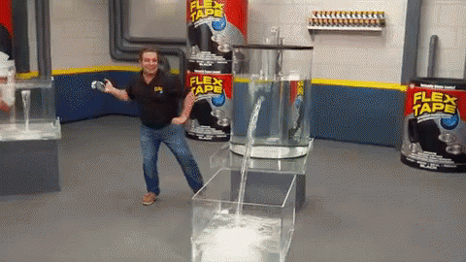
Remove the Server Header

Slide 29
Remove the Server Header
Remove Server Header
By default ASP.NET Core adds a “Server Header”
This says “Kestrel”
This exposes to black hats what you’re running
Focuses exploiting known CVEs

Slide 30

Don’t use IOptions…

Slide 31
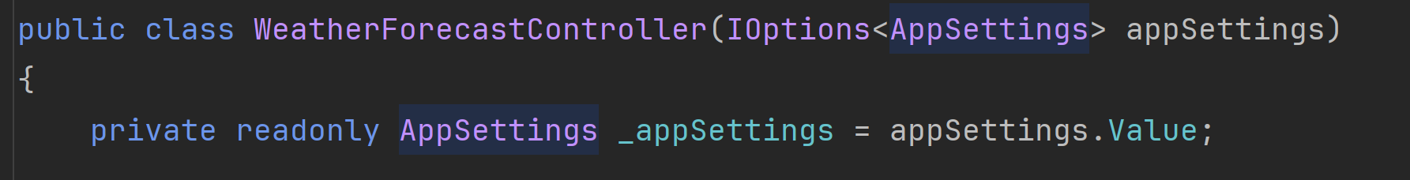
Problem: IOptions is annoying
Don’t use IOptions
Dependency on Microsoft.Extensions.Options down in other csproj’s
Testing IOptions is slightly annoying with Options.Create()
.Value everywhere adds friction
scottsauber

Slide 32
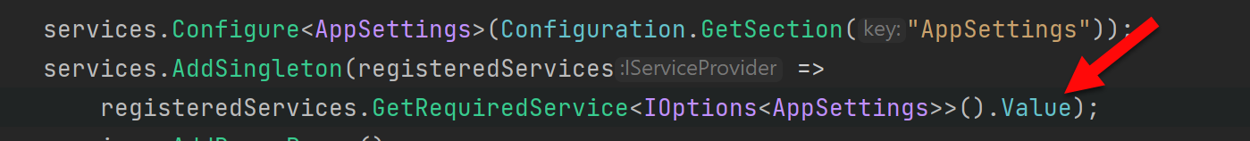
Solution: Register your Options class directly
Don’t use IOptions
scottsauber

Slide 33
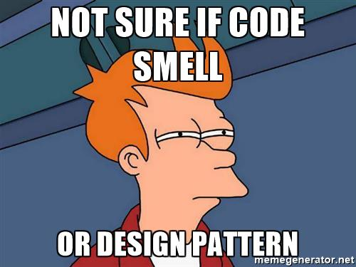
Code Smells

Slide 34
Structuring a method
Code Smells
Happy Path always at the bottom of the method
Don’t want to scan for “what happens when all goes well” and find it in the middle of a method
Use return’s instead of nested if => else
scottsauber

Slide 35
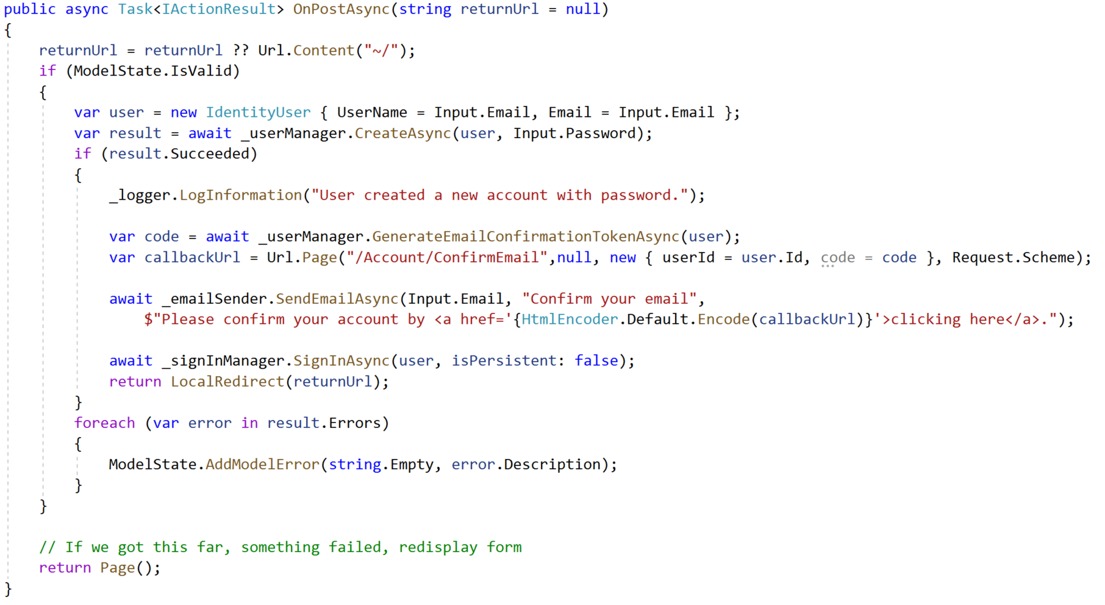
Razor Pages Template Code:
Code Smells

Slide 36
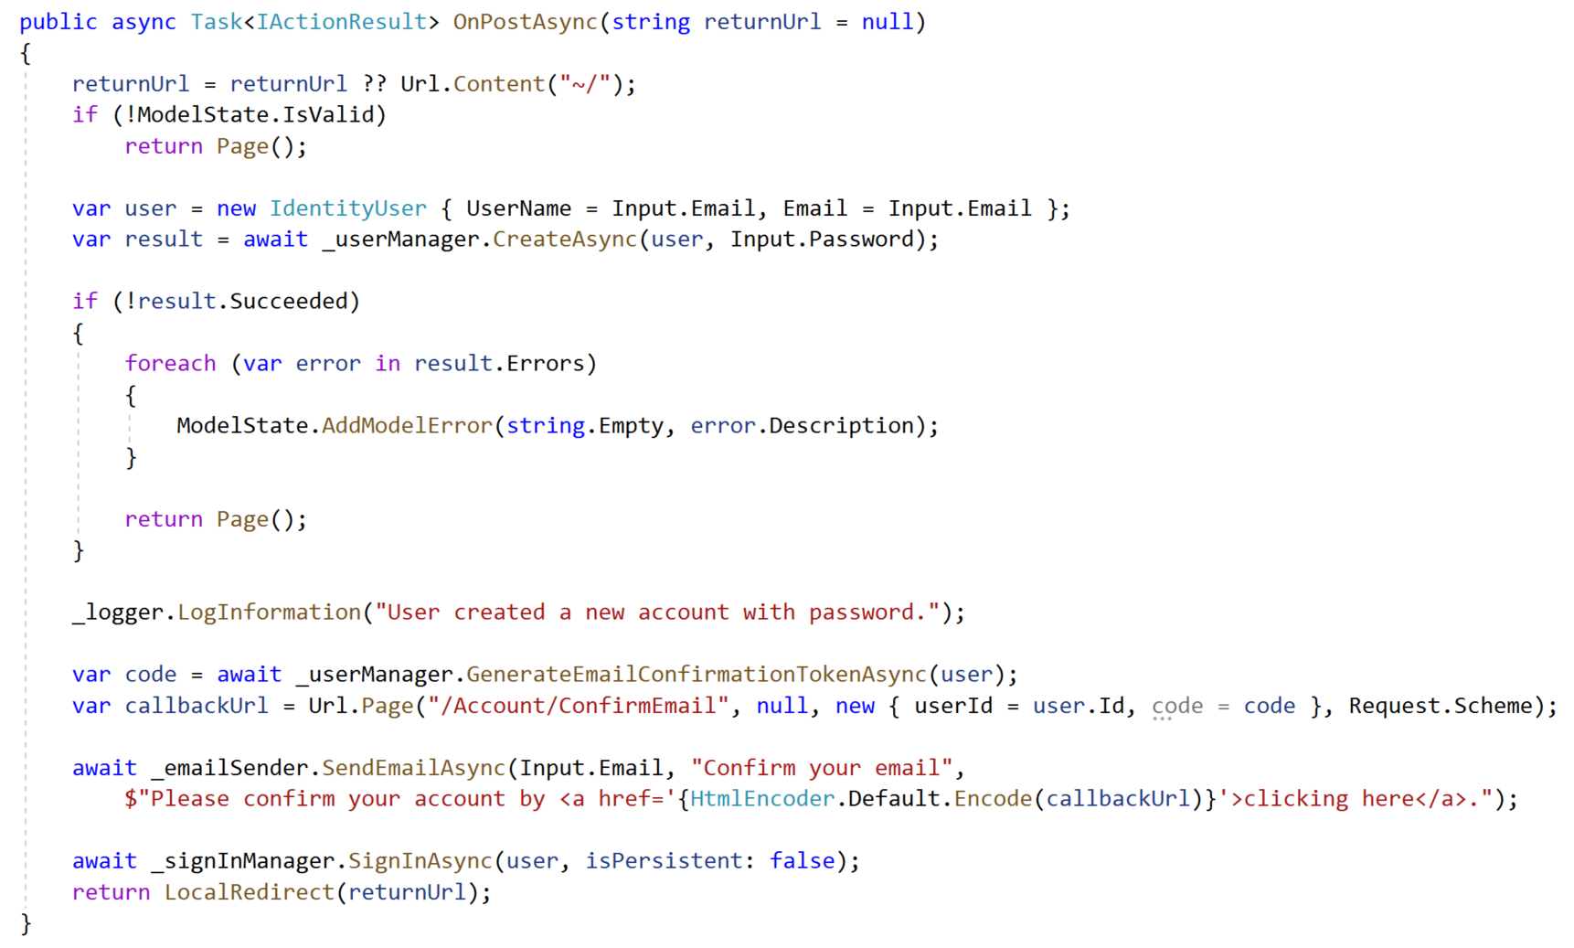
Refactored with Happy Path At The Bottom:
Code Smells

Slide 37
The Indentation Proclamation
Code Smells
The more indented your code is, the harder it is to follow
Nested if’s, nested loops, etc.
…I made this up
scottsauber

Slide 38

Code smells
Code Smells
Not hard and fast rules, just my “warning light”
Methods > 20 lines
Classes > 200 lines
Regions
You probably should’ve added a new class or method instead

Slide 39
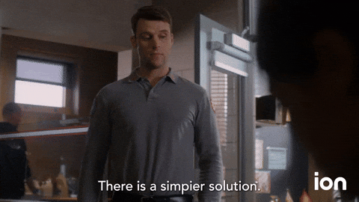
Modern Solution Files

Slide 40
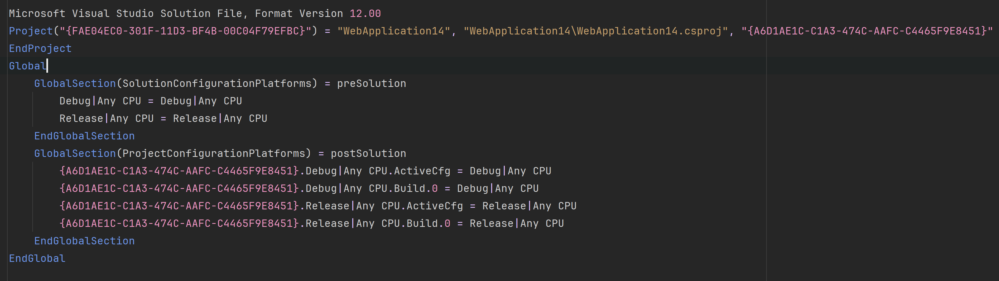
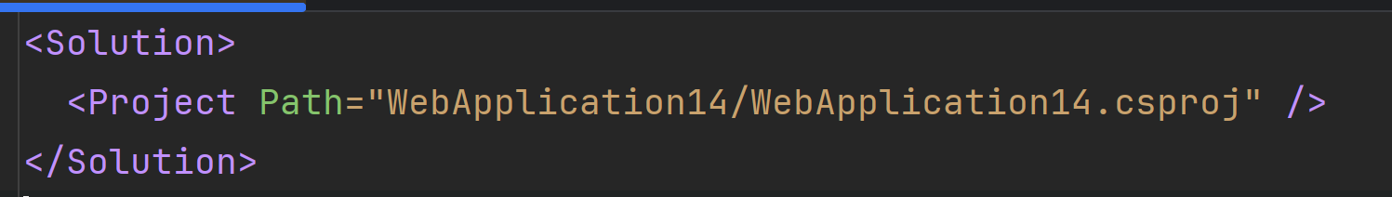
Modern Solution Files!
Modern Solution Files
slnx - .NET SDK 9.0.200+, feature still in preview
dotnet sln migrate

Slide 41
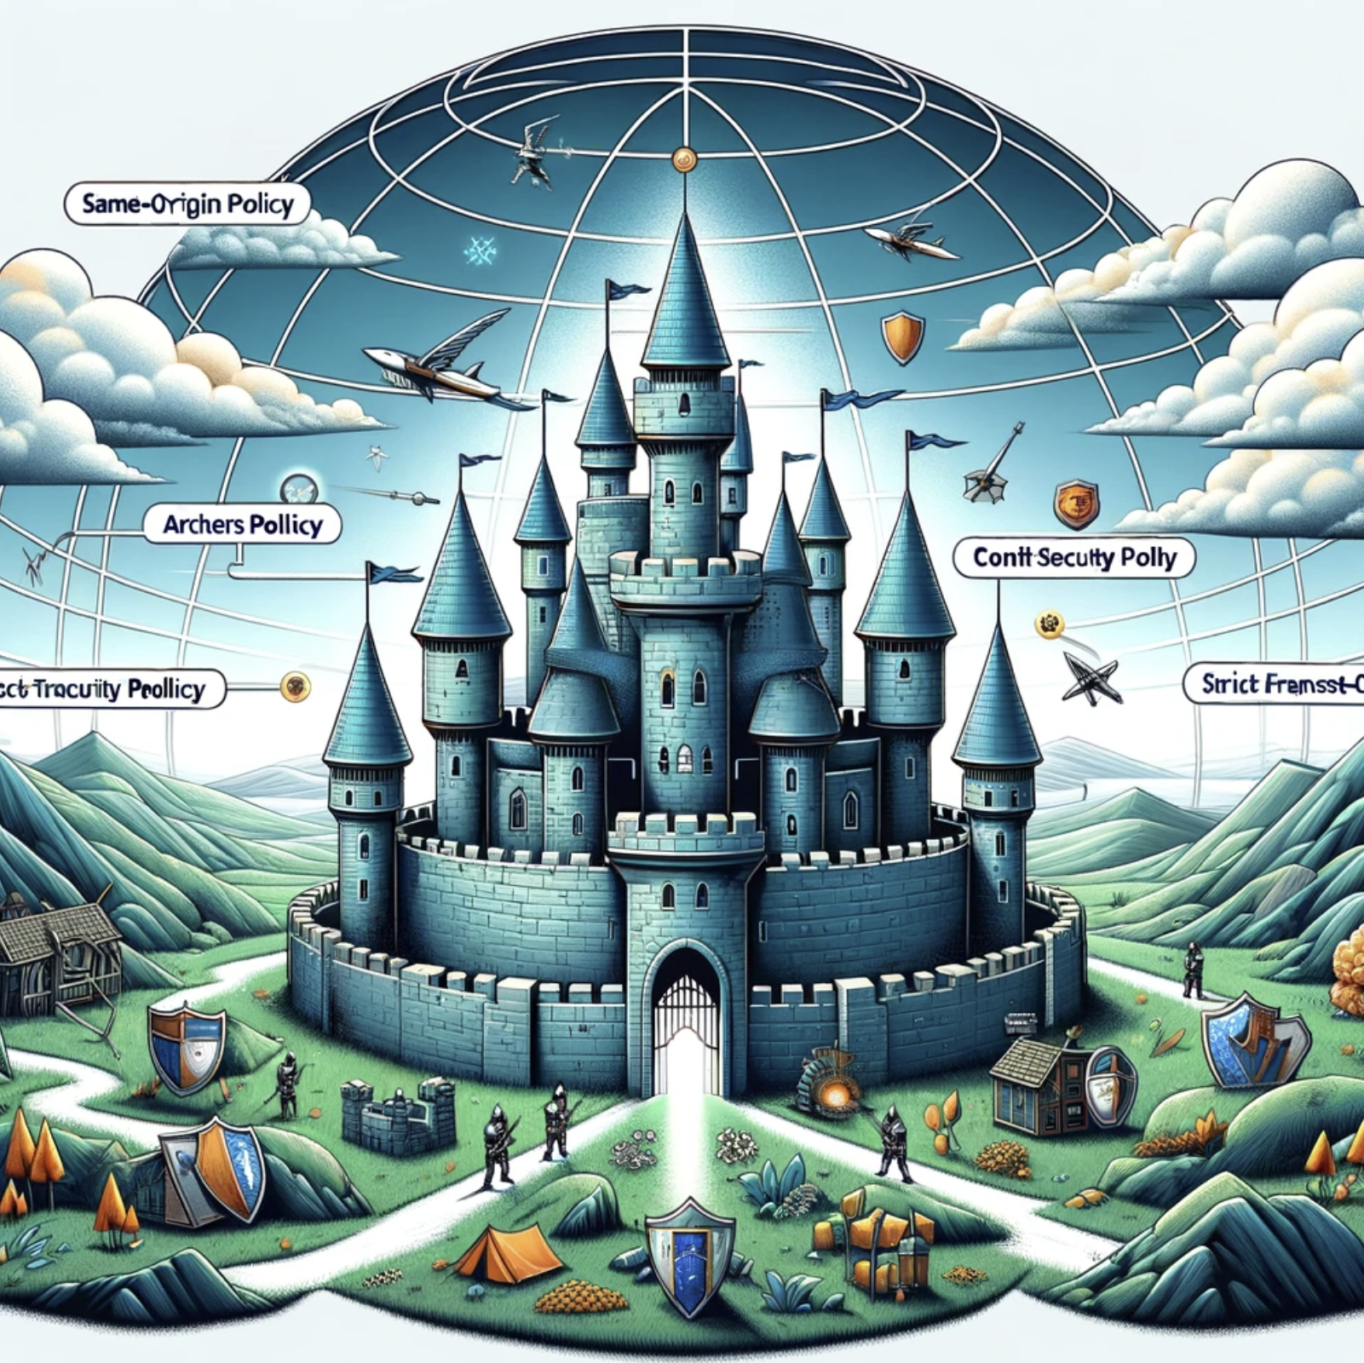
HTTP Security Headers

Slide 42
HTTP Security Headers
HTTP Security Headers
Tells a browser what extra rules to enforce
Protects against MITM, clickjacking, cross-site scripting, and more
Be careful!
NetEscapades.AspNetCore.SecurityHeaders

Slide 43
Resources
HTTP Security Headers
My talk deep diving on this topic: https://www.youtube.com/watch?v=7MWXTXjtl8s

Slide 44

Build Once, Deploy Many Times

Slide 45
Build Once, Deploy Many Times
Build Once, Deploy Many
Discourages Long Running Branches and GitFlow
Encourages Trunk Based Development (even with PRs)
Atlassian calls Gitflow “a legacy workflow”
DORA Research promotes Trunk Based Development
Environmental differences (i.e. config, secrets) live in the environment

Slide 46

ValidateOnBuild

Slide 47
ValidateOnBuild
ValidateOnBuild
Singletons can only depend on Singletons
The “captive dependency” problem
ASP.NET Core will catch this when running in Development but not other environments
If you have a custom local env name…

Slide 48
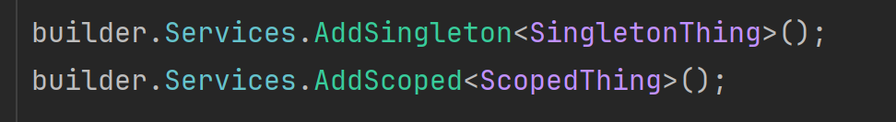
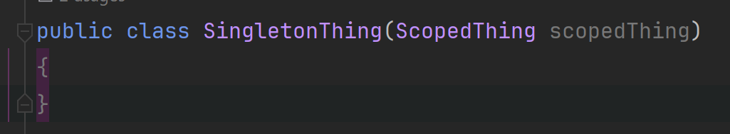
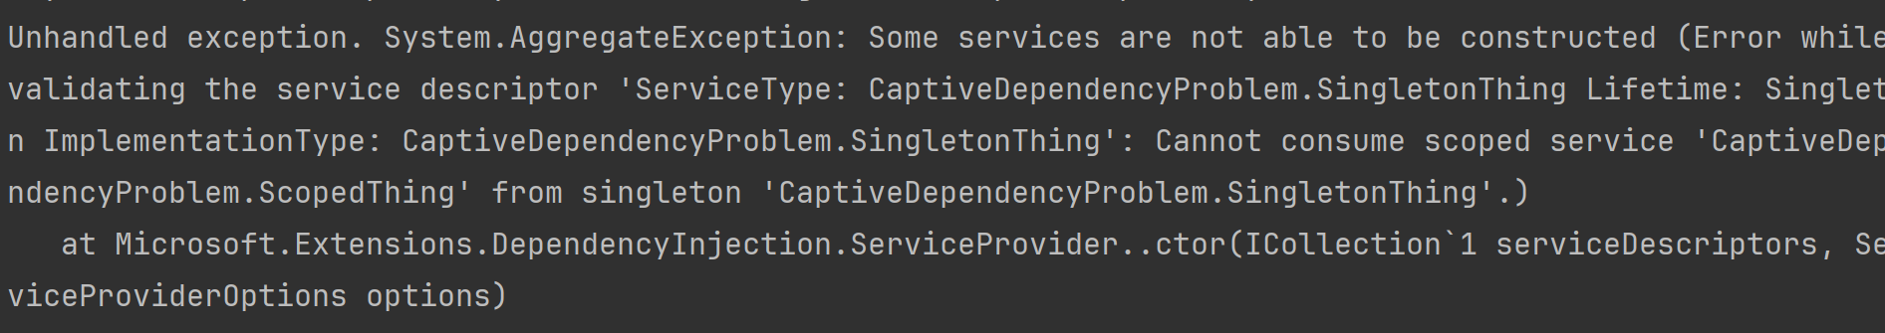
ValidateOnBuild
ValidateOnBuild

Slide 49
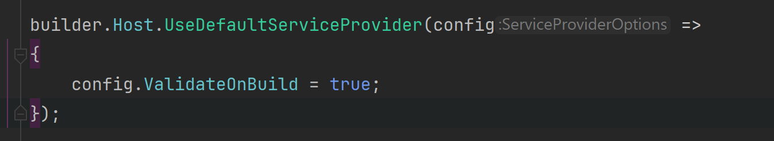
ValidateOnBuild
ValidateOnBuild

Slide 50

Automated Tests

Slide 51
Automated Testing with xUnit
Automated Tests
You should be writing automated tests
Exposes holes in your architecture
Proven to be faster long-term
Make changes quickly and confidently because have a regression test suite
DORA Research proving automated testing results in improved stability, reduced burnout, and lower deployment pain
Use xUnit or NUnit
Just not MSTest which is wayyy more verbose and has less features
xUnit used by ASP.NET team
Note: there’s an xUnit.v3 package, which is diff than xUnit package
scottsauber

Slide 52
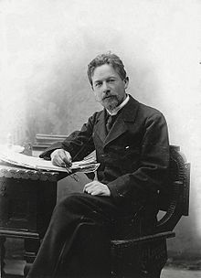

Chekhov’s Gun
Automated Tests
scottsauber

Slide 53
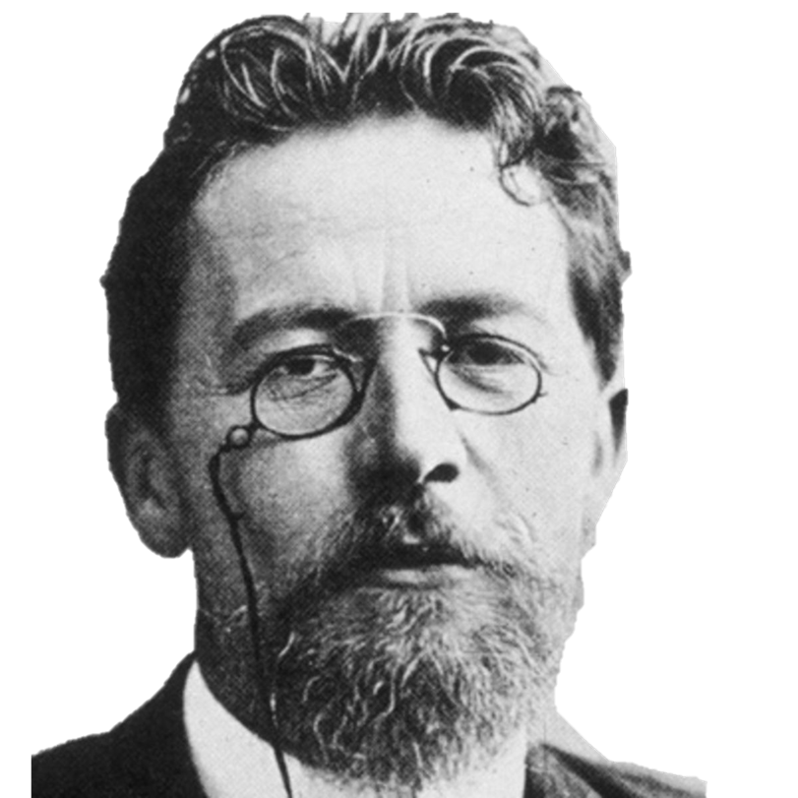
“Remove everything that has no relevance to the story. If you say in the first chapter that there is a rifle hanging on the wall, in the second or third chapter it absolutely must go off. If it's not going to be fired, it shouldn't be hanging there.” Anton Chekhov

Slide 54
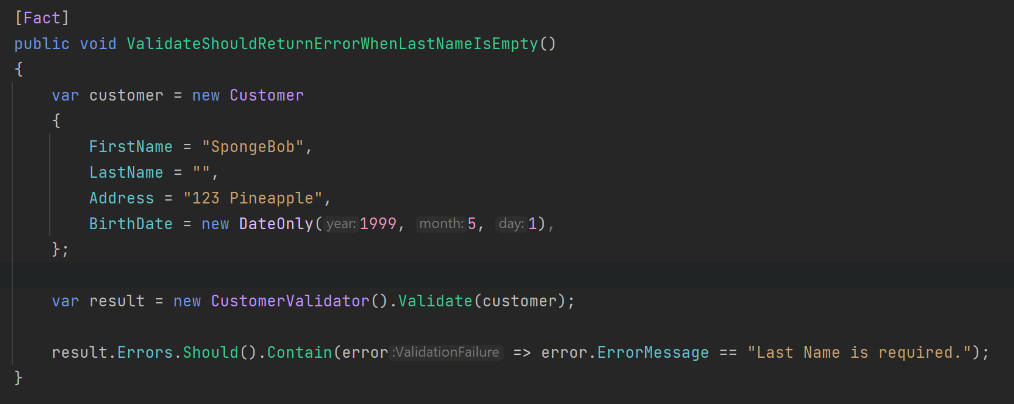
Chekhov’s Gun Applied to Testing
Automated Tests
scottsauber

Slide 55
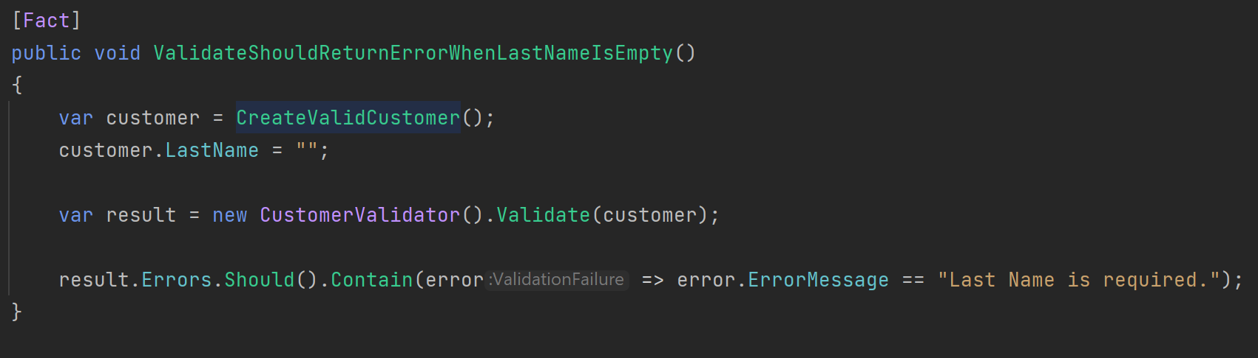
Chekhov’s Gun Applied to Testing
Automated Tests
scottsauber

Slide 56
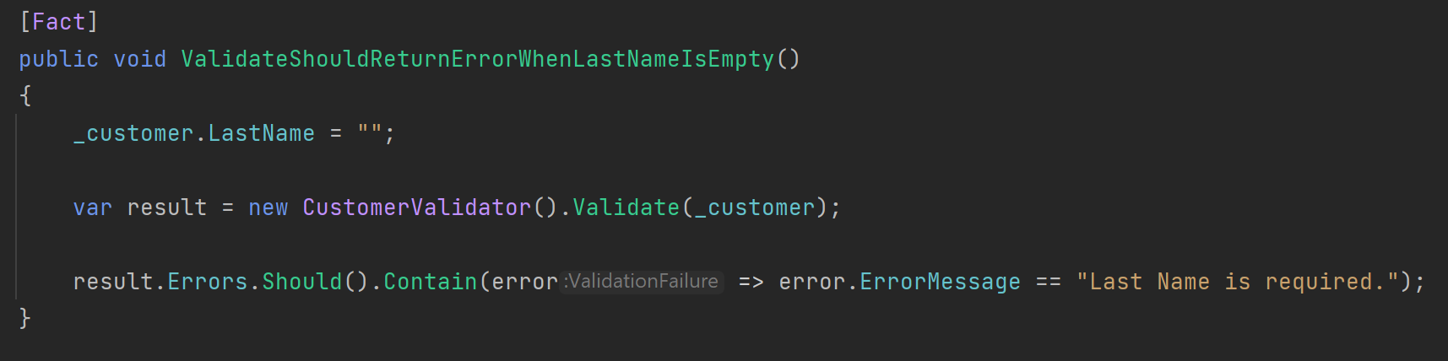
Chekhov’s Gun Applied to Testing
Automated Tests
scottsauber

Slide 57
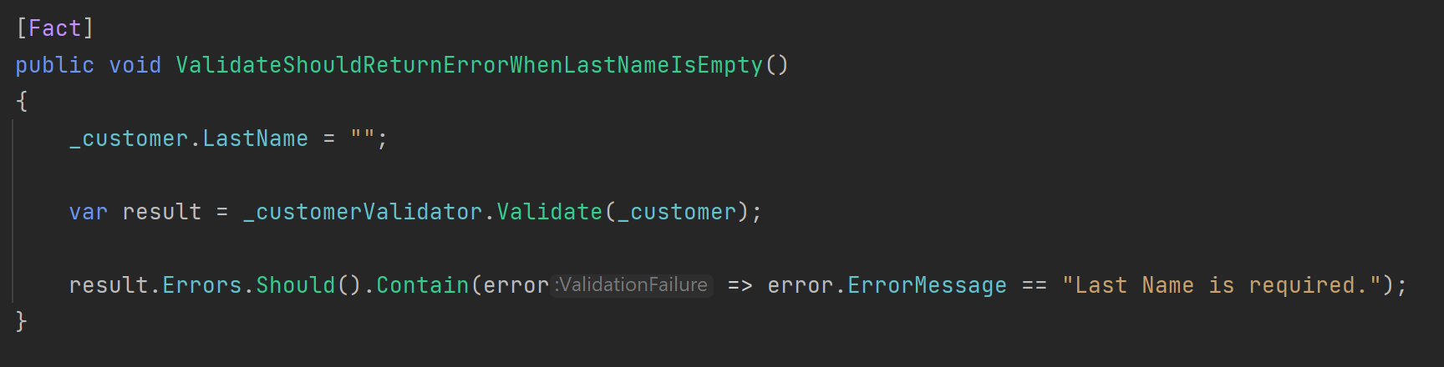
Chekhov’s Gun Applied to Testing
Automated Tests
scottsauber

Slide 58
Chekhov’s Gun Applied to Testing
Automated Tests
scottsauber

Slide 59

Central Package Management

Slide 60
Problem
Central Package Management
Same package in multiple projects across your solution
Annoying to keep version in sync
Tests projects especially
I find most people don’t know Central Package Management exists
scottsauber

Slide 61
Solution: Central Package Management
Central Package Management
Added in .NET 6
Create Directory.Packages.props at the root and define packages and versions there
Omit Version attribute in PackageReference
All packages will have to omit the Version attribute
Can override with VersionOverride attribute
scottsauber

Slide 62
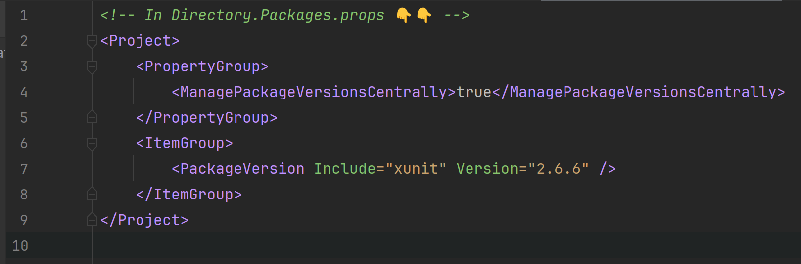
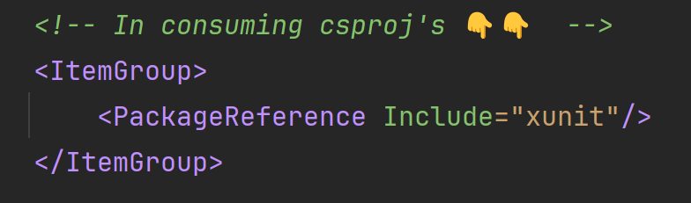
Solution: Central Package Management
Central Package Management
scottsauber

Slide 63

BONUS

Slide 64
Ever wonder what SQL Queries EF is making?
Bonus!
Switch log level of Microsoft.EntityFrameworkCore.Database.Command to Information
Only do this for local development
scottsauber

Slide 65
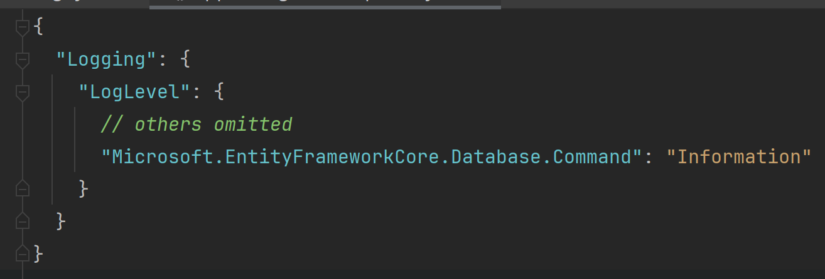
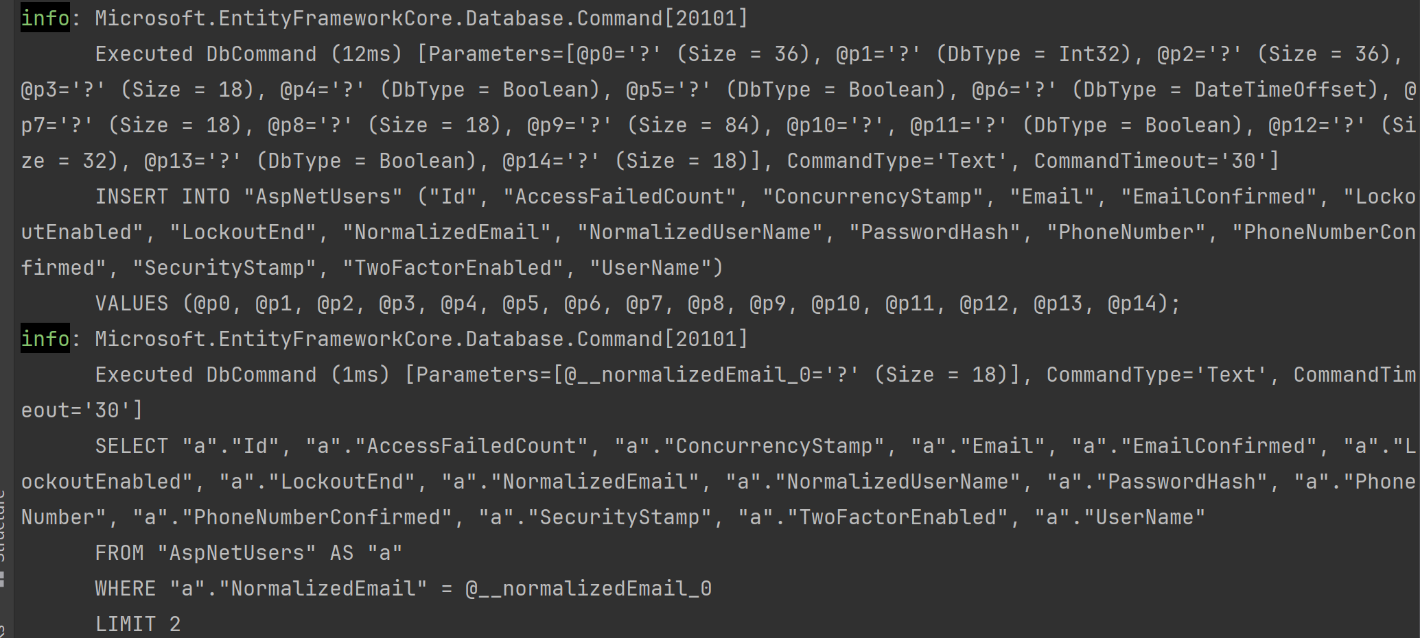
Ever wonder what SQL Queries EF is making?
Bonus!
scottsauber

Slide 66
More Bonus!
Bonus!
CI/CD Pipelines
Confident Green
Feature Toggles
Work in small batches
Deploy frequently to Production (should be daily or more frequent)
scottsauber

Slide 67
Real benefits of these practices
1 company went from deploying to Prod 12x a year (rolling back half of those) to 2000x a year (rolling back <1% of those)
Faster, more reliable delivery of value to users
DORA Metrics
scottsauber

Slide 68
Takeaways
Hopefully you got at least one idea today
This slide deck is your resource – up at scottsauber.com (and will post to Slack)
scottsauber

Slide 69

Questions? ssauber@leantechniques.com @scottsauber.com on Bluesky @scottsauber on Twitter
Slides at scottsauber.com
scottsauber

Slide 70
Thanks!
Slides at scottsauber.com
scottsauber

